Slide 1
Microprocessor System Design
Omid Fatemi
Memory Interfacing
(omid@fatemi.net)

Slide 2
Class Work #3
Memory Interfacing - 8088

Slide 3
First Part – Closed-Book

Slide 4
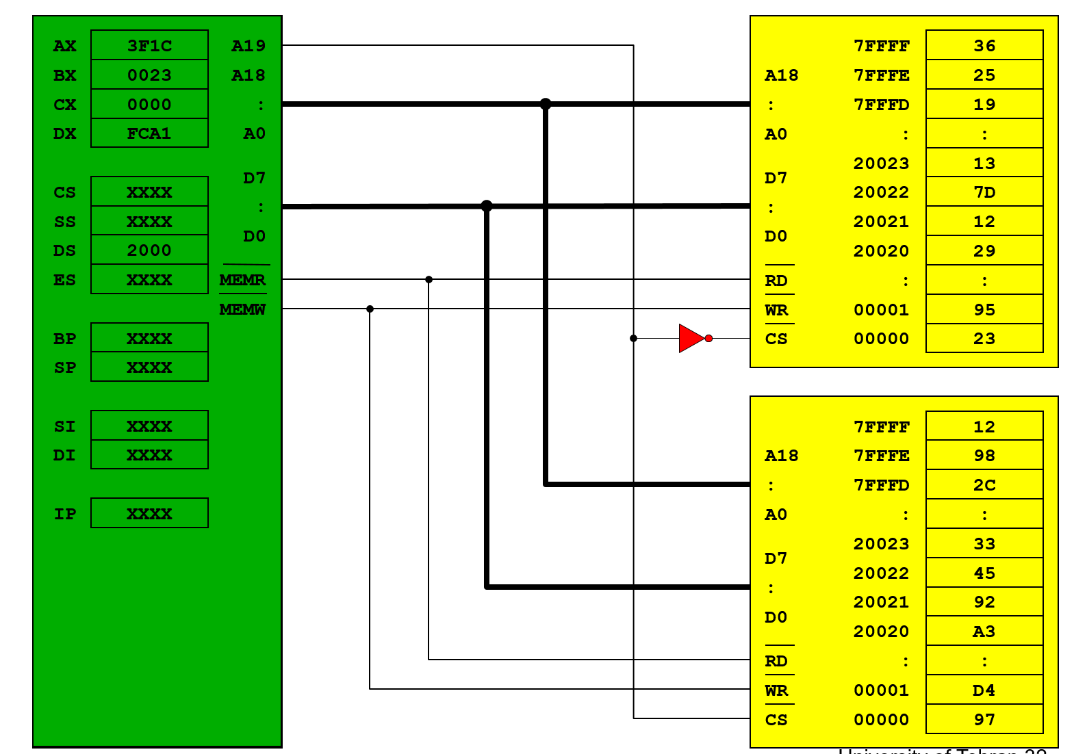
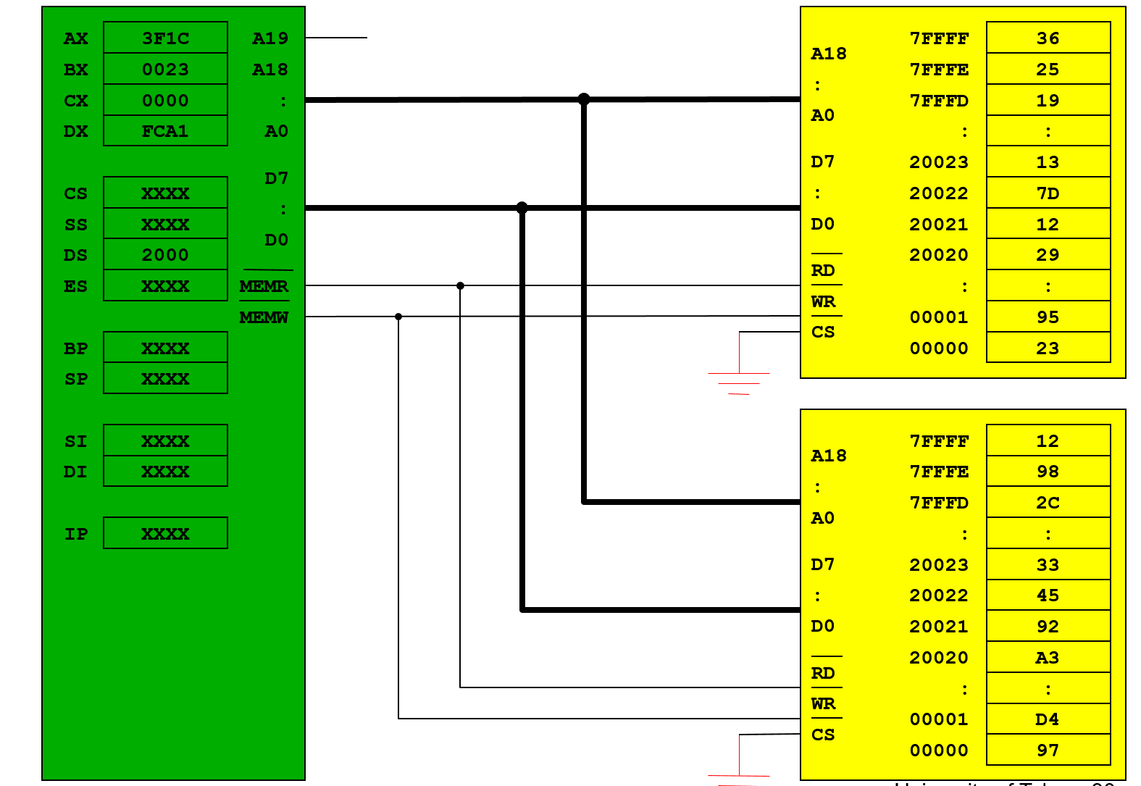
Questions
What is full decoding? And what is the problem with partial decoding?
What is the address range of the top memory in this design?
What is the problem with this design?
Notes:
What is the difference between DRAM and SRAM?
What is the problem with this design?
What is full decoding? And what is the problem with partial decoding?
Explain two kinds of ROM variations.

Slide 5
Second Part – Open-Note

Slide 6
Problems
There are two types of memory modules:
512k x 4 bit SRAM for 00000-7FFFF
512k x 8 bit ROM for 80000-FFFFF
How many modules are required from each type.
Design the circuit.

